Slide 1
FFT AND ITS PROPERTIES AND RADIX-2 FFT ALGORITHM

Slide 2

INTRODUCTION
FFT
FFT computes the DFT and produces exactly the same result as evaluating the DFT definition directly; the most important difference is that an FFT is much faster. Let x₀... x_{N−1} be complex numbers. The DFT is defined by the formula
A fast Fourier transform (FFT) algorithm computes the discrete Fourier transform (DFT) of a sequence, or its inverse (IFFT). Fourier analysis converts a signal from its original domain (often time or space) to a representation in the frequency domain and vice versa.

Slide 3
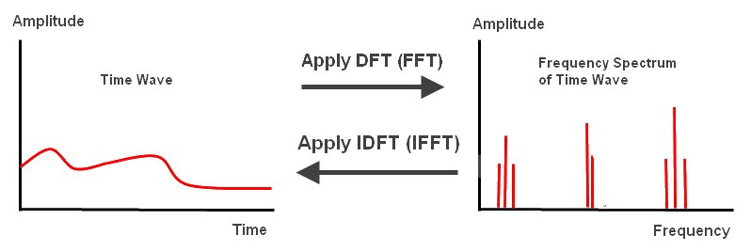
REPRESENTATION OF FFT IN TIME AND FREQUENCY DOMAIN

Slide 4
METHODS TO COMPUTE FFT
Divide and conquer approach
Radix-2 (DIT,DIF)
Radix-4 (DIT,DIF)
Split radix
2. Linear filtering
Geortzel algorithm
Chirp-z transform

Slide 5
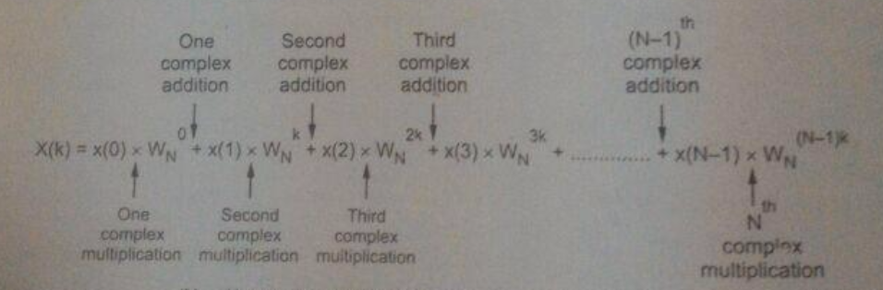
IMPORTANCE OF FFT OVER DFT
The results of the FFT are the same as with the DFT; the only difference is that the algorithm is optimized to remove redundant calculations. In general, the FFT can make these optimizations when the number of samples to be transformed is an exact power of two, for which it can eliminate many unnecessary operations.
The DFT is obtained by decomposing a sequence of values into components of different frequencies. This operation is useful in many fields but computing it directly from the definition is often too slow to be practical.

Slide 6
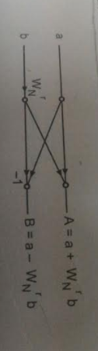
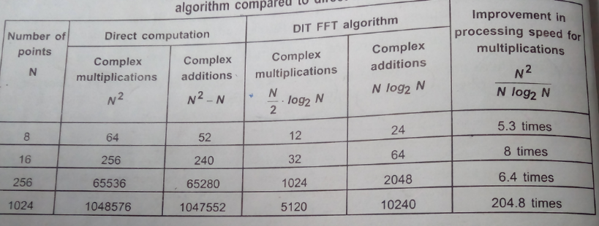
WHY FFT IS BETTER?
An FFT is a way to compute the same result more quickly: computing the DFT of N points in the naive way, using the definition, takes O(N²) arithmetical operations, while an FFT can compute the same DFT in only O(N log N) operations.
there are N/2 butterflies in every stages. Where N=2^v. v=log₂N.
No of multiplication will be =( N/2).v = (N/2) log₂N.
No of addition will be =2(N/2). log₂N= N.log₂N

Slide 7
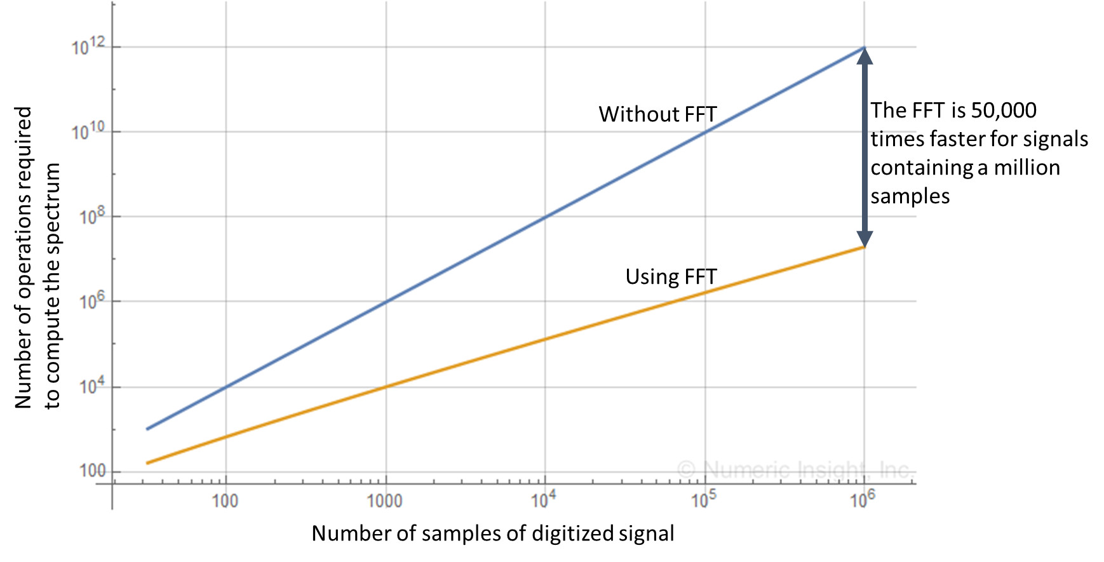
SPEED OF FFT COMPUTATION

Slide 8

PROPERTIES
Periodicity property-
This property states that
Proof:
W_{N} is represented by
Since e^{−j2π} = 1, therefore we get
Hence proved.

Slide 9


Symmetry property
This property states that
Proof:
W_{N} is represented by
Since e^{−jπ} = −1, we have
Hence proved.

Slide 10



This property states that
We know that ,
Putting N by N/2, we get
Hence proved.

Slide 11
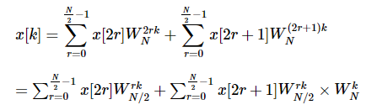

RADIX-2
There are many algorithms to implement fft. The one used here is radix2 decimation in time method.
Radix 2 algorithms are based on divide and conquer approach.
In this the N-point DFT is successively decomposed into smaller DFTs such that the smallest DFT will be of size N=2.
The formula for radix 2 dit is
The divide and conquer procedure consists of twiddle factors
This is used recursively in fft thereby reducing the time of computation.

Slide 12
SEQUENCE DIVISION IN TIME DOMAIN

Slide 13
BUTTERFLY COMPUTATION METHOD
This is the fundamental or basic computation in FFT algorithms.
Observe the two values ‘a’ and ‘b’ are available as input.
From these two values ‘A’ and ‘B’ are computated at output as shown in the figure.
This operation is called the butterfly operation.
A signal flow graph is made up of such butterflies.

Slide 14
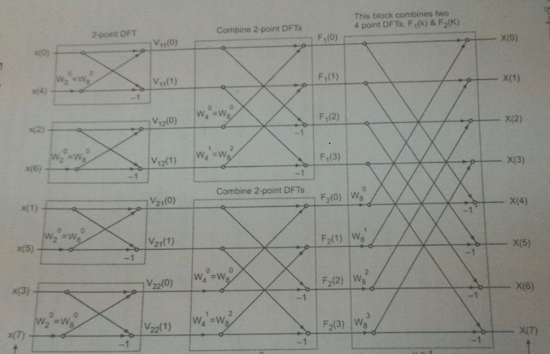
BUTTERFLY DIAGRAM FOR 8 POINT DFT

Slide 15
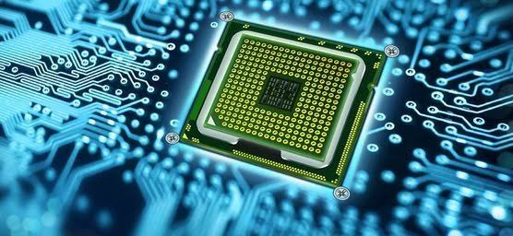
APPLICATIONS
FPGA DESIGN
A field-programmable gate array is an integrated circuit designed to be configured by a designer after manufacturing.

Slide 16

MRI AND IMAGE PROCESSING
Digital image processing is the use of computer algorithms to perform image processing on digital images.

Slide 17
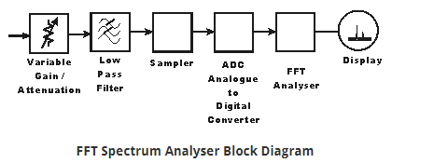
SPECTRUM ANALYSER
A spectrum analyser measures the magnitude of an input signal versus frequency within full frequency range of the instrument.

